Slide 1


Slide 2

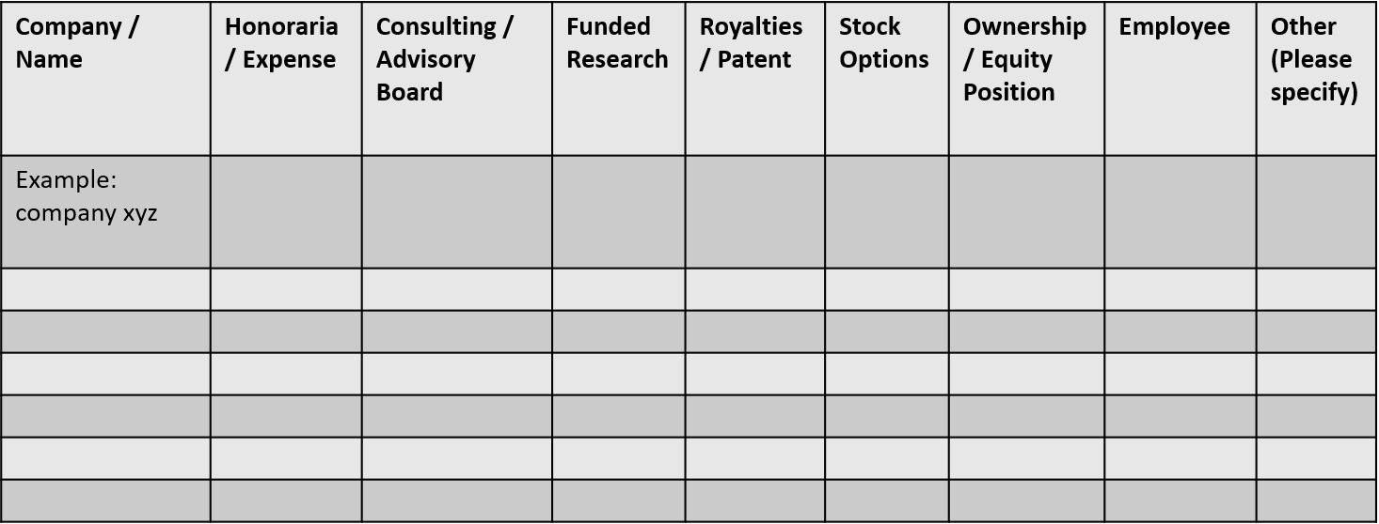
 | No, Nothing to disclose
 | Yes, please specify

